Slide 1

Deep Learning Project Presentation On Image Captioning
Group MEMBERS- 1. AJAY KUMAR PAL
2. Bijin elsa baby
3. KISLAY SINHA
4. PRABHAKAR KUMAR

Slide 2
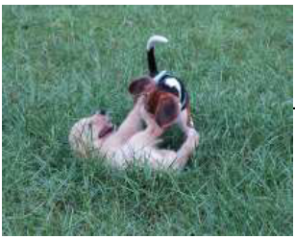
PROJECT DESCRIPTION
Image captioning is the task of generating a descriptive and appropriate sentence of a given image.
Two tasks involved:
Understand the content of the image.
Turn the understanding of the image into words in proper order.
Caption generation is a challenging AI problem where a textual description must be generated for a
given image.
Potential Applications:
Aiding visually impaired
Generating video summary using individual frames
Neural
Networks
Two Dogs are wrestling
In the grass

Slide 3
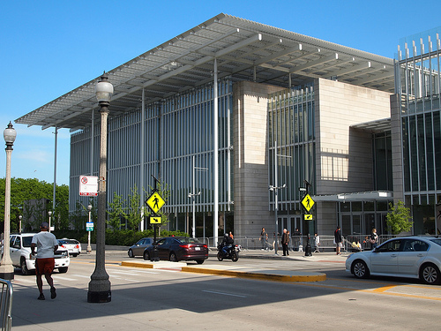
DATASET
We used Stanford Image Paragraph
Captioning dataset.
Stanford Dataset Contains Variety of
images depicting scenes and situations.
The dataset consists of 19561 images and
each image has a corresponding paragraph
which consists of more than one caption.
We split the whole image dataset into 14579,
2492, & 2490 images as training, validation &
testing sets respectively.
A large building with bars on the
windows in front of it.
There is people walking in front
of the building.
There is a street in front of the
building with many cars on it.

Slide 4
TEXT PREPROCESSING
Each description is tokenized and converted to lowercase
Removed alpha-numeric characters and punctuation marks
We use startseq and endseq as prefix and postfix for each caption respectively
Filtered out unique words from the corpus and represented each word by an integer
To generate a fixed length word vector we calculated the maximum length caption

Slide 5
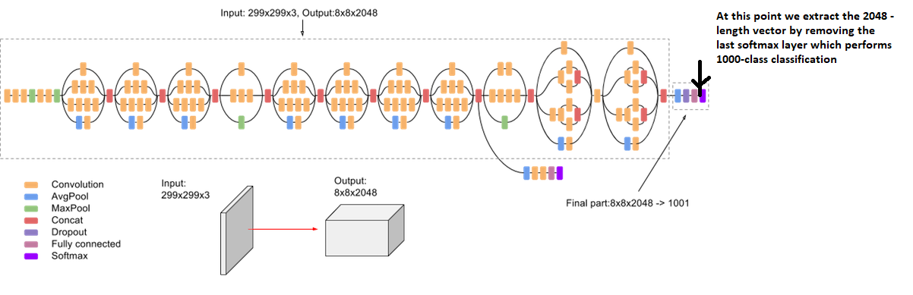
IMAGE FEATURE GENERATION
Resized all images to a fixed size of 299x299x3 using OpenCV
Employed transfer learning using pre-trained InceptionV3 CNN model to encode images
We removed the last softmax layer from the InceptionV3 network to extract 2048 image
vector

Slide 6
DATA GENERATION

Slide 7
Word EMBEDDING
Two popular examples of methods of learning word embeddings from text include:
o Word2Vec
o GloVe
Word2Vec-
Technique used for learning word association in a NLP task. The algorithms in word2vec use a neural network model so that once a trained model can identify synonyms and antonyms words or can suggest a word to complete a partial incomplete sentence. Word2vec uses a list of numbers that can be called vectors to represent any distinct word. The cosine similarity between the vectors is used as the mathematical function for choosing the right vector which indicates the level of semantic similarity between the words.
Glove-
GloVe word is a combination of two words- Global and Vectors. In-depth, the GloVe is a model used for the representation of the distributed words. This model represents words in the form of vectors using an unsupervised learning algorithm. This unsupervised learning algorithm maps the words into space where the semantic similarity between the words is observed by the distance between the words. These algorithms perform the Training of a corpus consisting of the aggregated global word-word co-occurrence statistics, and the result of the training usually represents the subspace of the words in which our interest lies.

Slide 8
CNN + LSTM ARCHITECTURE

Slide 9
CNN MODEL
VGG19
efficientNetV2L
Inception_resnet
Resnet_50

Slide 10
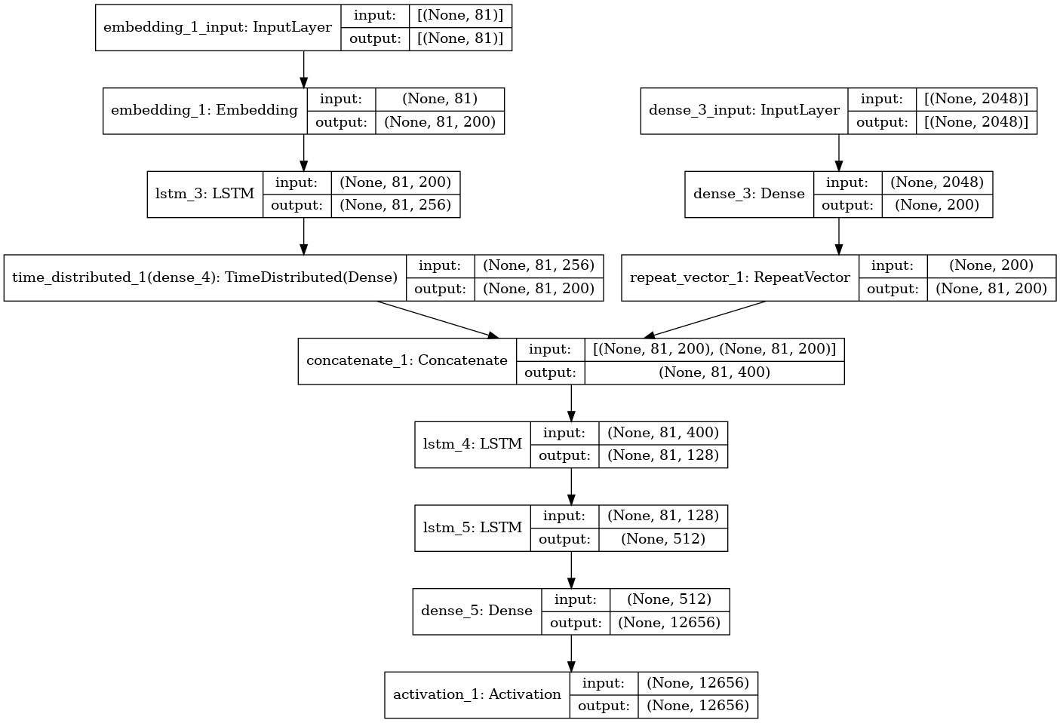
LSTM MODEL

Slide 11
GENERATING PREDICTIONS
Caption is predicted word by word
Image is fed along with the first word(startseq) to the RNN to predict the second word
Again the same image along with first word + second word is fed to the RNN to predict the third word and so on until the last word(endseq) is encountered
Target Word
(i = 0) little
(i = 1) boy
(i = 2) …
Neural Network
Model
(i = 0) startseq
(i = 1) startseq little
(i = 2) …

Slide 12
GENERATING PREDICTIONS(GREEDY & BEAM SEARCH)
Greedy Search Approach
In the greedy decoder, we considered a single word at every step
We start with the <START> token, input image features and then generate the first word based on probability from the LSTM Model
Then we feed in the corresponding predicted word embedding as input and generate the next word based on probability from the next LSTM.
It keeps going until <END> token is received.
Beam Search Approach
In this method we could track multiple words at every step and use those to generate multiple hypotheses
We define how many words(k) we want to keep at every step
The algorithm keeps track of k words along with its score, each seeded from the previous top scoring k words

Slide 13
EVALUATION METRICS
Bilingual Evaluation Understudy Score (BLEU)
BLEU is a metric for evaluating a generated sentence to a reference sentence
BLEU score lies between 0 and 1
Feature Model | BLEU-1 Score | BLEU-2 Score
VGG19 | 0.63169 | 0.40558
efficientNetV2L | 0.64462 | 0.42623
Inception_resnet | 0.62436 | 0.40550
Resnet_50 | 0.52365 | 0.39456

Slide 14
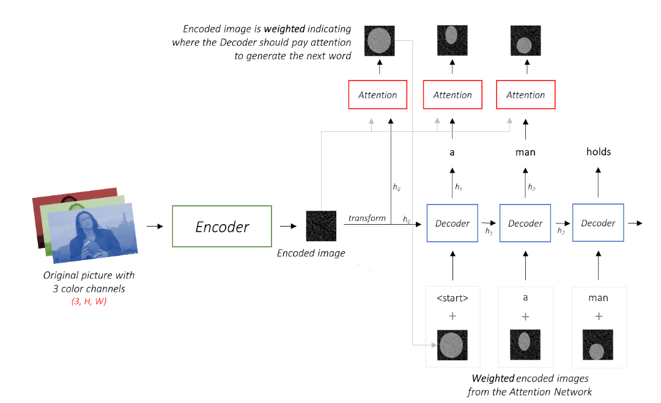
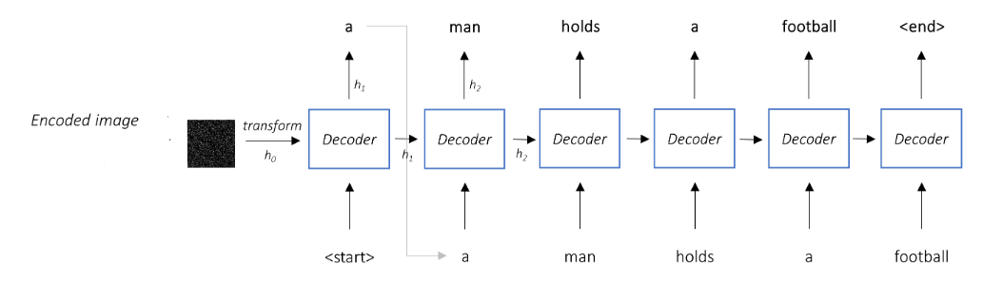
ATTENTION
Without attention
With attention

Slide 15
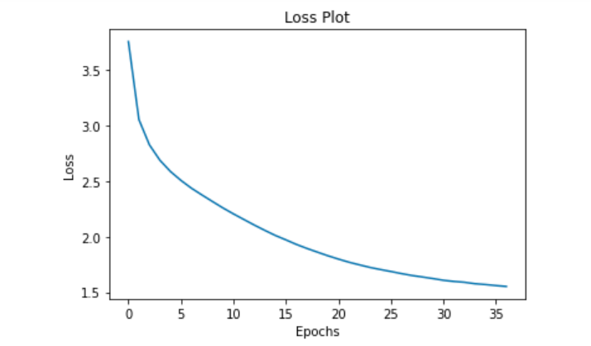
ATTENTION
Models Used: Inception v3 and LSTM
Framework: Pytorch 1.10.2+cu102
Training Loss

Slide 16
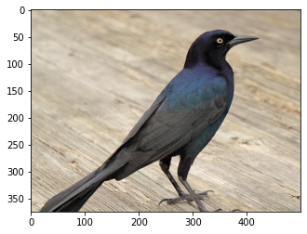
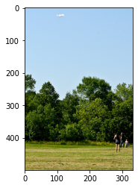
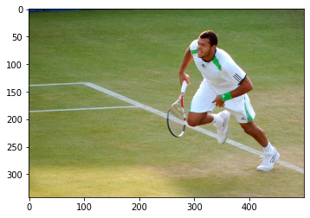
a bird is perched on a branch
Results(With Greedy Search)
Output-
a bird is perched on a branch. the bird is light brown colour. The bird has a long beak.
Output-
a man is standing on a grassy field. He is wearing black shirt and
Black pants.
Output-
a man is standing on a tennis court playing tennis. he is wearing white shirt and blue shorts.

Slide 17
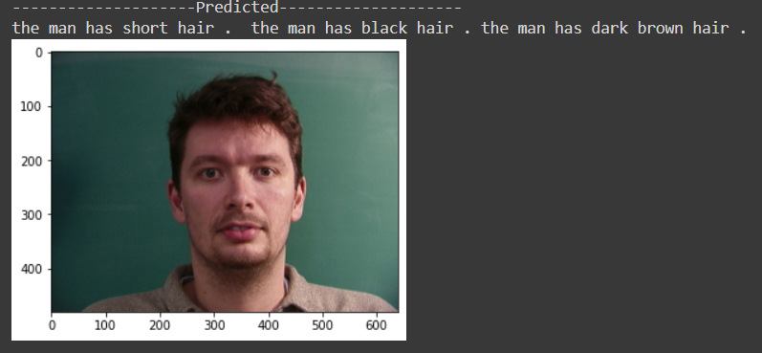
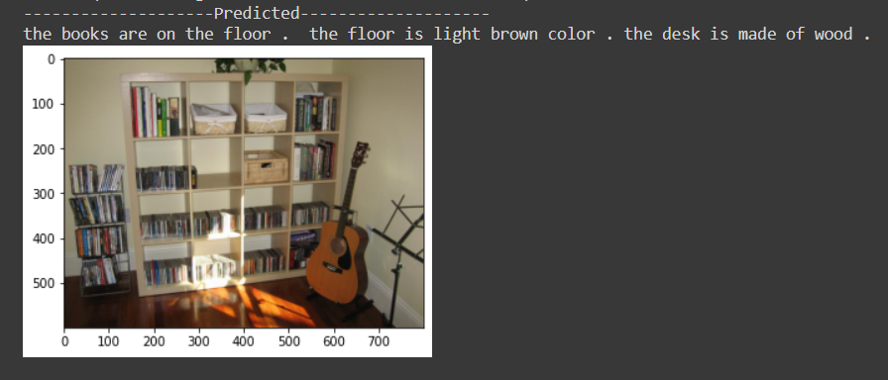
a bird is perched on a branch
Results(With BEAM Search)

Slide 18
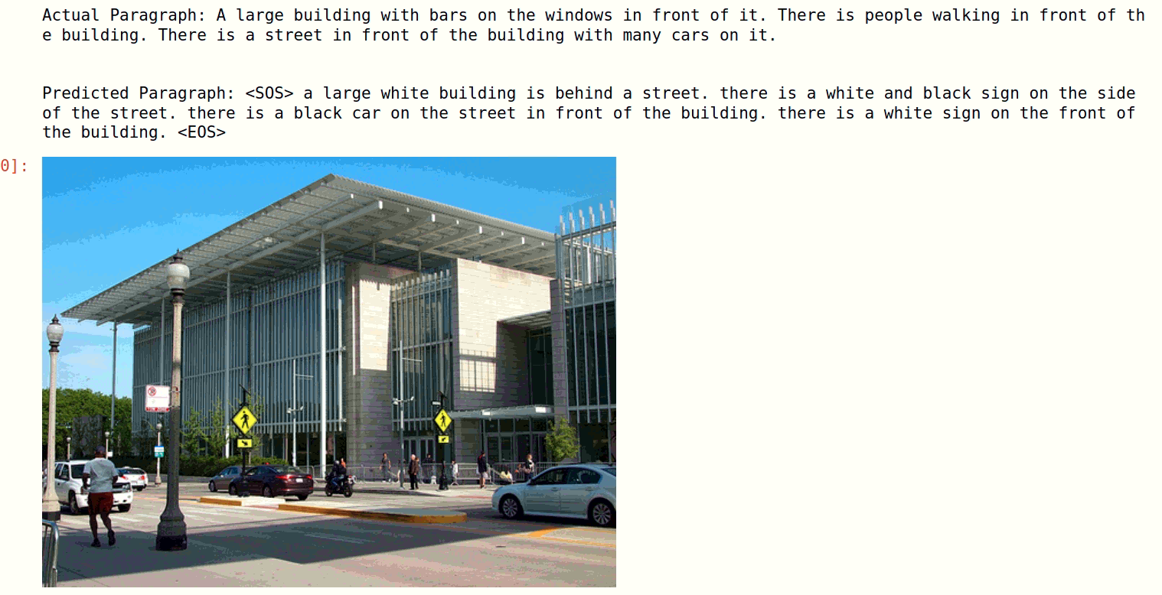
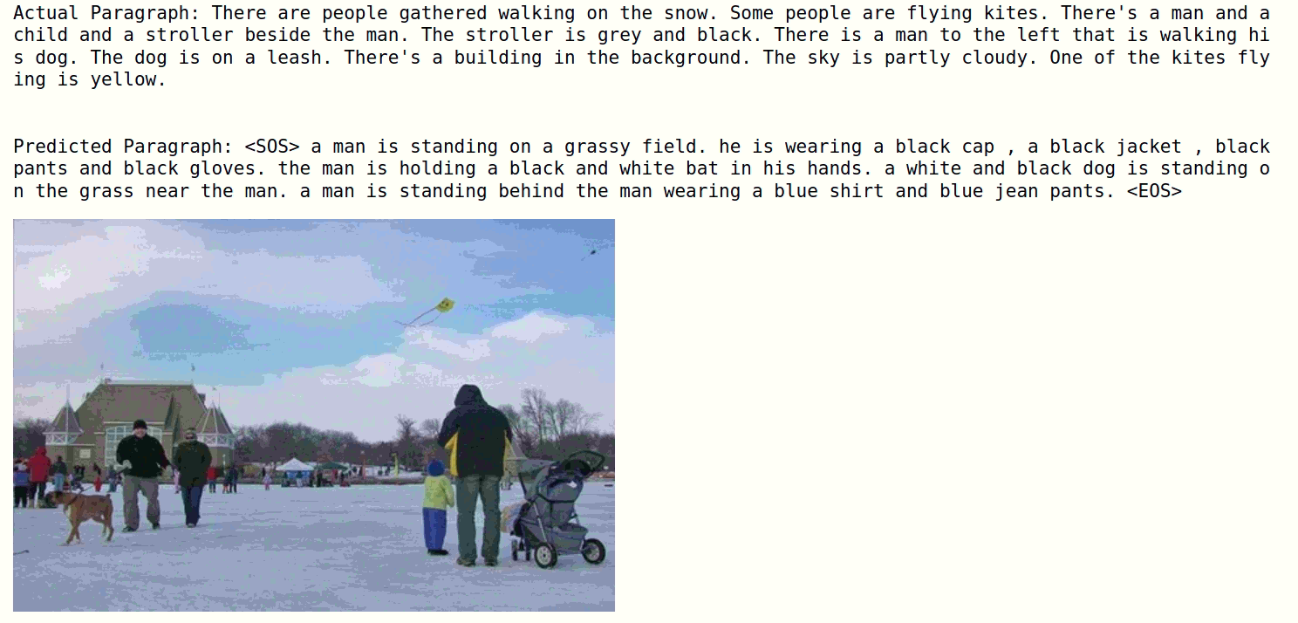
RESULTS (WITH ATTENTION)

Slide 19
THANK YOU

